Slide 1
SiS Update Firmware Flow 說明（I2C）
2023/3/6

Slide 2
SiS Commands Table
參考文件:
SiS98xx_I2C_Cmd_Table_V01.xls
使用81, 82, 83, 84, 85, 86等Commands的規格與定義
7501_F321_I2CUpdate_Bootloader.tdc (Use the Total Phase Data Center tool)
包含Boot Loader的更新程序
7501_F321_I2CUpdate.tdc (Use the Total Phase Data Center tool)
不包含Boot Loader的更新程序
crc.c; crc.h

Slide 3
Packet format
Output packet : master send to slave
Input packet : master receive from slave
建議設定值
Output Register :0x40 (byte 0 LSB) ，0x01 (byte 1 MSB)
Output Report ID :0x09 (byte 4)
Input Report ID :0x0A (byte 2)

Slide 4

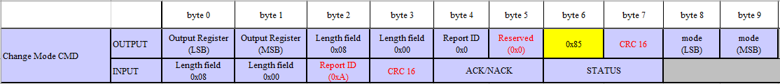
Command 85
設定FW 操作模式。
執行Update FW flow前，設定FW為 Update FW mode
0x85 (byte 6) 0x09 (byte 9) 0x51 (byte 8)
0x85 (byte 6) 0x01 (byte 9) 0x21 (byte 8)
ModeType | byte8 | byte9
DISABLE_DIAGNOSIS_MODE | 0x20 | 0x01
ENABLE_DIAGNOSIS_MODE | 0x21 | 0x01
PWR_CMD_FWCTRL | 0x50 | 0x09
PWR_CMD_ACTIVE | 0x51 | 0x09

Slide 5
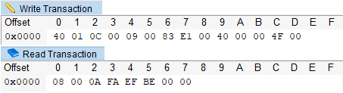
Command 83
指定燒錄ROM 位置&長度。
ROM 位置 需align 4Kbyte，little-endian
例如:0x00 00 40 00 -> 0x00(byte 8) 0x40 (byte 9) 0x00 (byte 10) 0x00 (byte 11)
長度是總共幾筆84 cmd (packet number)，little-endian
例如燒入4K的資料
長度 (4*1024)/52=78packet…40byte =>78+1=79(0x4F)

Slide 6
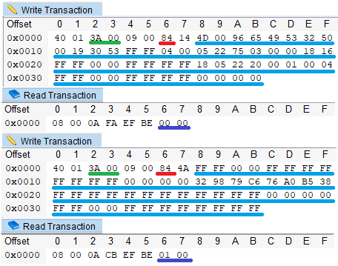
Command 84
傳送FW data
Length field (byte 2)=6 bytes header(byte 2~byte7) + payload(byte8~byte n)
(例 0x3A = 0x06 + 0x34 payload)
可帶入FW bin data 長度4Bytes ~52Bytes (例 0x34 payload-FW bin data )
Input packet 會回傳已接收幾個0x84 packets Byte 6 ,Byte 7 (little-endian)
(例 接收一個0x84 packet 0x00 0x00，接收二個0x84 packet 0x01 0x00 )

Slide 7
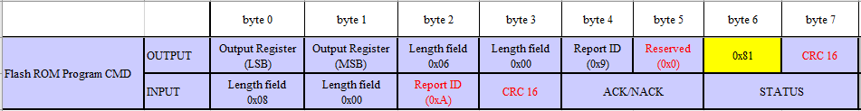
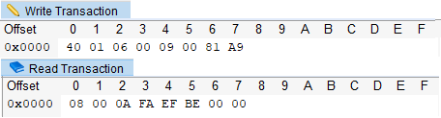
Command 81
燒錄 FW data 到ROM
將多個84 command的packets 傳送的FW bin data 燒錄到ROM

Slide 8
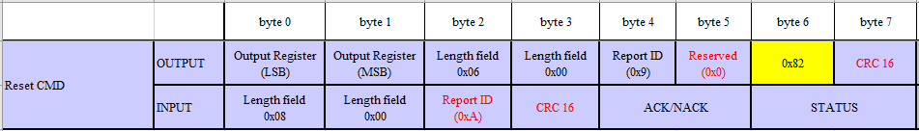

Command 82
FW 重置
FW 燒錄更新完後，需執行FW重置。
因為FW 收到82 CMD會馬上執行重置，所以會有接收不到input packet現象

Slide 9
Flash ROM map
Flash size :128Kbyte FW Bin size:124Kbyte
注意 Update FW只需要更新 0~124K位置(0x0-0x1f000)。
Boot-flag若不為\x50\x38\x31\x30，代表燒錄不完整，FW停留在boot-loader, 等待更新流程，此時Main code無法操作.
No. | Start address | Block name | Length
1 | 0x000000 | Boot loader code | 0x04000
2 | 0x004000 | Main code | 0x1B000
3 | 0x01f000 | Remain section | 0x01000
name | Start address | Length(byte) | Data
Boot flag | 0x001E000 | 0x04 | 0x50383130

Slide 10
Update FW Flow
The Update flow not include a boot loader block
The Update flow include a boot loader block
Burn order |  | Address – Length
1 | Clear boot –flag is 0 | 0x01E000 – 0x001000
2 | Burn main code | 0x004000 – 0x01A000
3 | Burn boot –flag | 0x01E000 – 0x001000
Burn order |  | Address – Length
1 | Clear boot –flag is 0 | 0x01E000 – 0x001000
2 | Burn main code | 0x004000 – 0x019000
3 | Burn boot loader code | 0x000000 – 0x004000
4 | Burn boot –flag | 0x01E000 – 0x001000

Slide 11
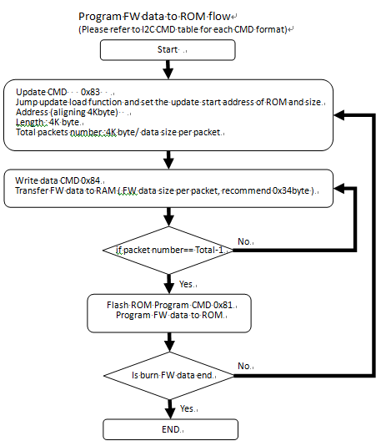
Update Flow Chart
Program FW data to ROM flow

Slide 12
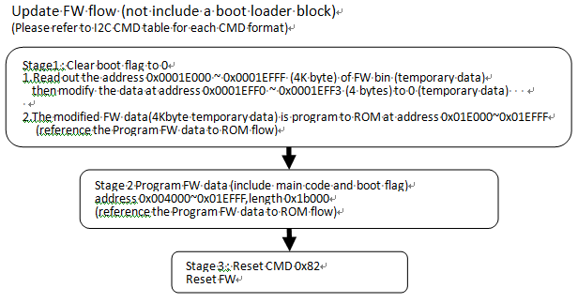
Update Flow Chart (not include a boot loader block)

Slide 13
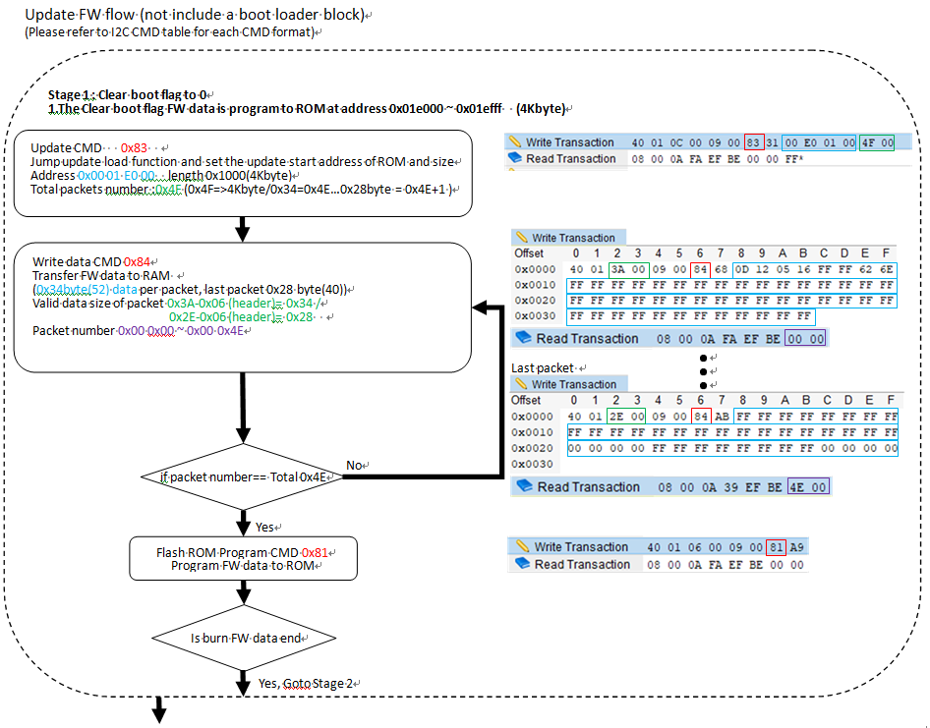
Update Flow Example…1/3
Update FW Flow
(not include a boot loader block)

Slide 14
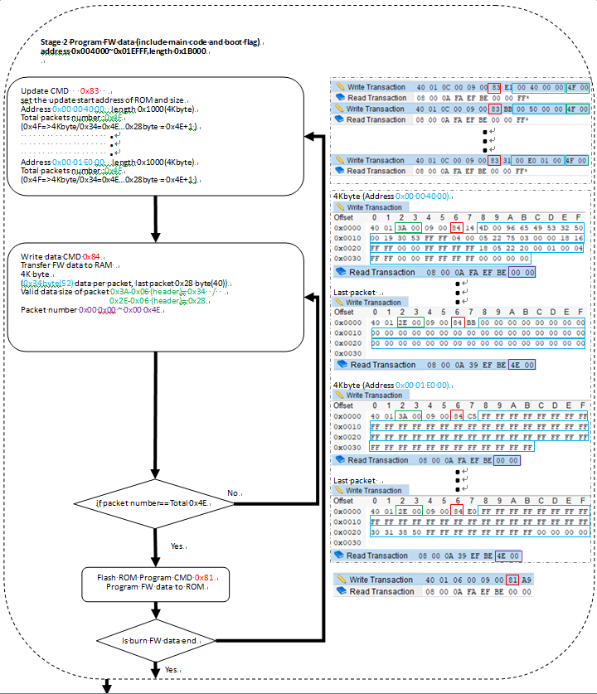
Update Flow Example…2/3

Slide 15

Update Flow Example…3/3

Slide 16
CRC
CRC請參考 CRC.h & CRC.c
Output packet CRC16計算 Byte6 + Byte8~pack length (沒有包含byte 7)
Input packet CRC16計算 Byte4~pack length (byte 7)
例如 crc16 = crc_check(((unsigned char *)&I2cTxPacket) + 4, m_HostPkgLen, 1);

Slide 17


Legal Disclaimer
Information in this document is provided for the evaluation of the potential business between Silicon Integrated Systems Corp. and you or other purposes agreed by Silicon Integrated Systems Corp. No license, express or implied, by estoppel or otherwise, to any rights or interests, including but not limited to intellectual property rights, is granted by this document.
SiS, , , HyperStreaming, Mirage, MuTIOL, 妙渠, Xabre, HyperZip,
SiS HyperZip Connect, PepLink, Glamo, CubicLook and MotionFixing are trademarks or registered trademarks of Silicon Integrated Systems Corp.
Other names and brands may be claimed as the property of others.
Copyright © (year), Silicon Integrated Systems Corp. All rights reserved.

Slide 18


